Slide 1
Jan. 14, 2022
CS 886 Deep Learning for Biotechnology
Ming Li

Slide 2
01. Word2Vec
02. Attention / Transformers
CONTENT
03. Pretraining: GPT / BERT
04. Deep learning applications in proteomics
05. Student presentations begin

Slide 3
Attention and Transformers
02
LECTURE TWO

Slide 4
02
Attention and Transformers
Plan: We trace back history to see how attention and transformers have emerged
Basic models, related to transduction models and attention.
Encoder-Decoder model, using recurrent networks such as LSTM.
Transformer models are general models sufficient for almost all biotech applications (graph models may be treated to be special cases too).
For example, DeepMind AlphaFold2 uses depends on a transformer architecture to train an end-to-end model.
The transformer model also makes it easy for large scale biological data (pre)training.

Slide 5
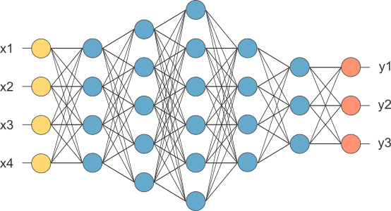
02
Attention and Transformers
1. Fully connected network, feedforward network
To learn the weights on
the edges

Slide 6
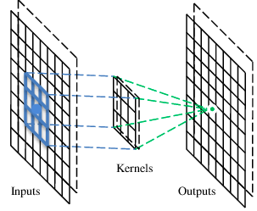
02
Attention and Transformers
2. CNN
A CNN is a neural network with some convolutional layers
(and some other layers). A convolutional layer has a number
of filters that do convolutional operation.
A filter

Slide 7
02
Attention and Transformers
These are the network parameters to be learned.
Convolutional layer
1 | -1 | -1
-1 | 1 | -1
-1 | -1 | 1
1 | 0 | 0 | 0 | 0 | 1
0 | 1 | 0 | 0 | 1 | 0
0 | 0 | 1 | 1 | 0 | 0
1 | 0 | 0 | 0 | 1 | 0
0 | 1 | 0 | 0 | 1 | 0
0 | 0 | 1 | 0 | 1 | 0
Filter 1
-1 | 1 | -1
-1 | 1 | -1
-1 | 1 | -1
Filter 2
……
Input
Each filter detects a small pattern (3 x 3).

Slide 8
Convolution
Operation
1 | -1 | -1
-1 | 1 | -1
-1 | -1 | 1
Filter 1
stride=1
1 | 0 | 0 | 0 | 0 | 1
0 | 1 | 0 | 0 | 1 | 0
0 | 0 | 1 | 1 | 0 | 0
1 | 0 | 0 | 0 | 1 | 0
0 | 1 | 0 | 0 | 1 | 0
0 | 0 | 1 | 0 | 1 | 0
Dot
product
3
-1
Input

Slide 9
Attention and Transformers
02
1 | -1 | -1
-1 | 1 | -1
-1 | -1 | 1
Convolution
Filter 1
stride=1
1 | 0 | 0 | 0 | 0 | 1
0 | 1 | 0 | 0 | 1 | 0
0 | 0 | 1 | 1 | 0 | 0
1 | 0 | 0 | 0 | 1 | 0
0 | 1 | 0 | 0 | 1 | 0
0 | 0 | 1 | 0 | 1 | 0
3
-1
-3
-1
-3
1
0
-3
-3
-3
0
1
3
-2
-2
-1
Input

Slide 10
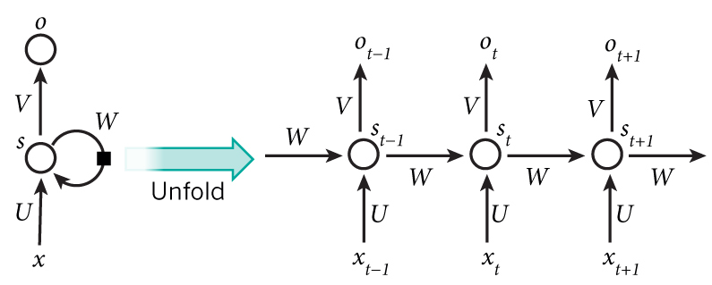
02
Attention and Transformers
3. RNN
Parameters to be learned:
U, V, W

Slide 11
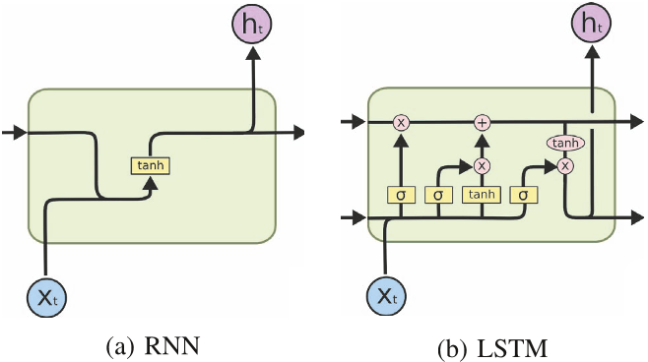
02
Attention and Transformers
Simple RNN vs LSTM

Slide 12
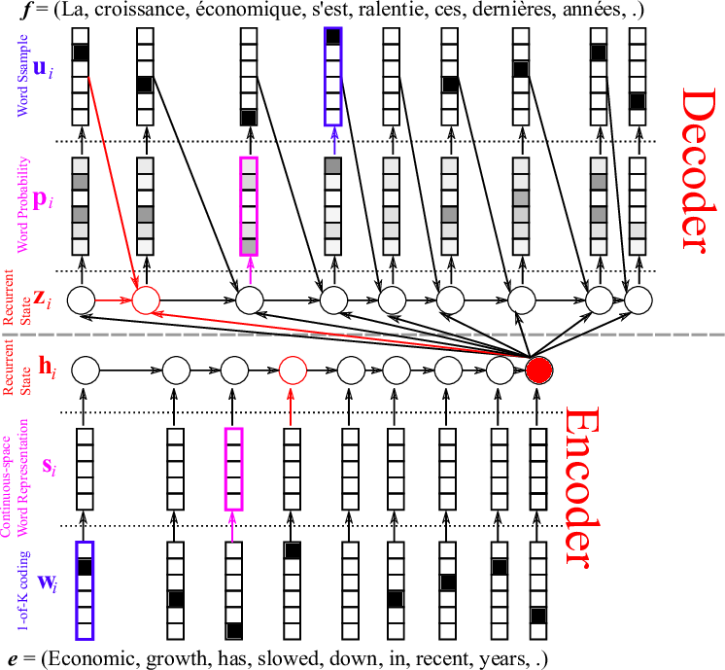
02
Attention and Transformers
Encoder-Decoder machine translation
LSTM

Slide 13
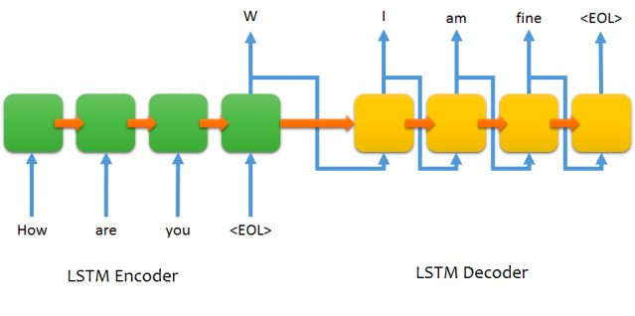
02
Attention and Transformers
Encoder-Decoder LSTM structure for chatting

Slide 14
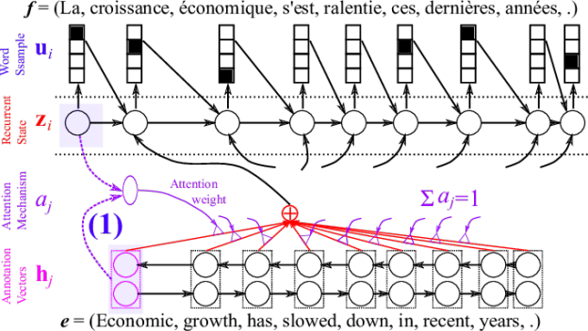
02
Attention and Transformers
Attention

Slide 15
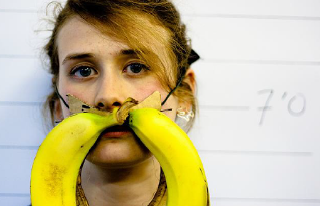
02
Attention and Transformers
Image caption generation using attention
A vector for each region
z⁰ is initial parameter, it is also learned
match
z⁰
0.7
CNN
filter
filter
filter
filter
filter
filter
filter
filter
filter
filter
filter
filter

Slide 16
02
Attention and Transformers
Image caption generation using attention
Word 1
A vector for each region
z⁰
z¹
Attention to
a region
weighted sum
CNN
filter
filter
filter
filter
filter
filter
0.7
0.1
0.1
0.1
0.0
0.0
filter
filter
filter
filter
filter
filter

Slide 17
02
Attention and Transformers
Image caption generation using attention
Word 1
Word 2
A vector for each region
z²
z⁰
z¹
weighted sum
CNN
filter
filter
filter
filter
filter
filter
0.0
0.8
0.2
0.0
0.0
0.0
filter
filter
filter
filter
filter
filter

Slide 18
02
Attention and Transformers
Image caption generation using attention
Kelvin Xu, Jimmy Ba, Ryan Kiros, Kyunghyun Cho, Aaron Courville, Ruslan Salakhutdinov, Richard Zemel, Yoshua Bengio,
“Show, Attend and Tell: Neural Image Caption Generation with Visual Attention”, ICML, 2015

Slide 19
02
Attention and Transformers
More new ideas:
ULM-FiT, pre-training, transfer learning in NLP
Recurrent models require linear sequential computation, hard to parallelize. ELMo, bidirectional LSTM.
In order to reduce such sequential computation, several models based on CNN are introduced, such as ConvS2S and ByteNet. Dependency for ConvS2S needs linear depth, and ByteNet logarithmic.
The transformer is the first transduction model relying entirely on self-attention to compute the representations of its input and output without using RNN or CNN.

Slide 20
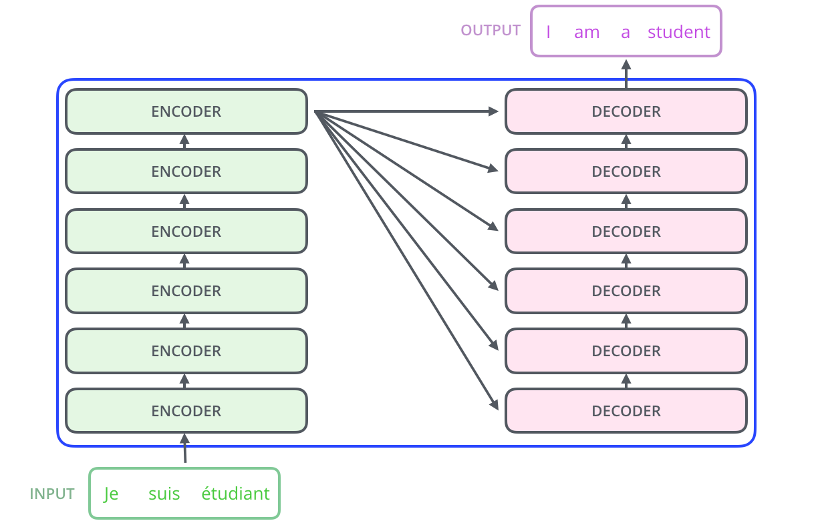
02
Attention and Transformers
Transformer

Slide 21
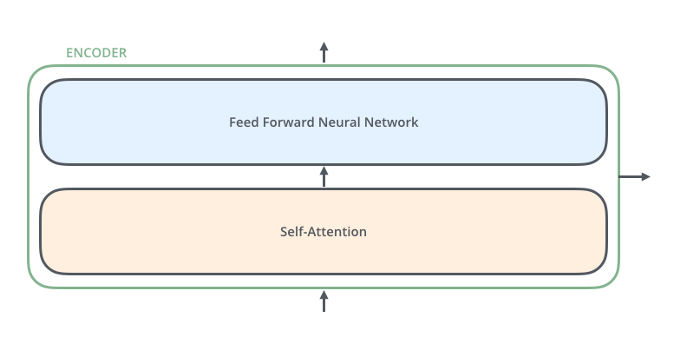
02
Attention and Transformers
An Encoder Block: same structure, different parameters

Slide 22
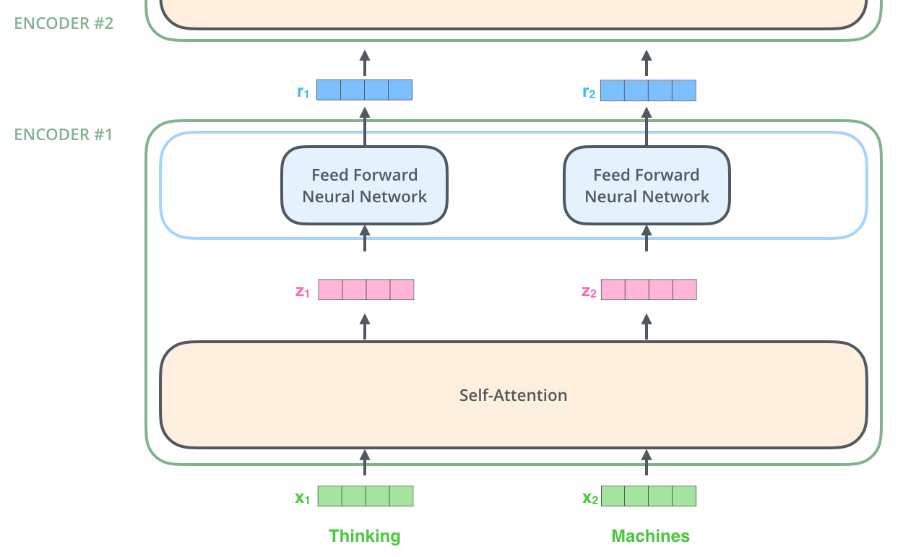
02
Attention and Transformers
Encoder
Note: The ffnn is independent
for each word.
Hence can be parallelized.

Slide 23
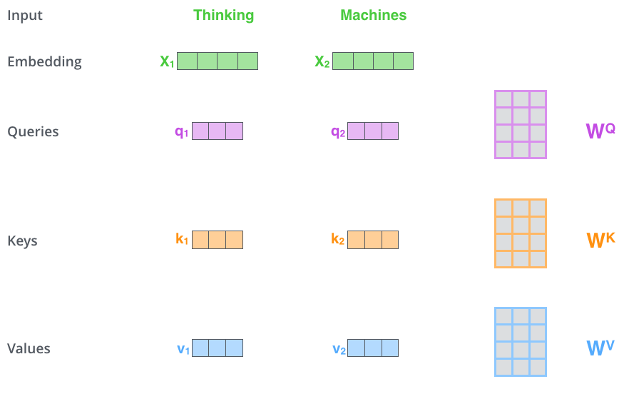
02
Attention and Transformers
Self Attention
512 → 4
64
64 → 3
512
First we create three vectors
by multiplying input embedding
(1x512)
x_{i} with three matrices (64x512):
q_{i} = x_{i} W^{Q}
K_{i} = x_{i} W^{K}
V_{i} = x_{i} W^{V}
Notes:
Dimension of q,k,v

Slide 24
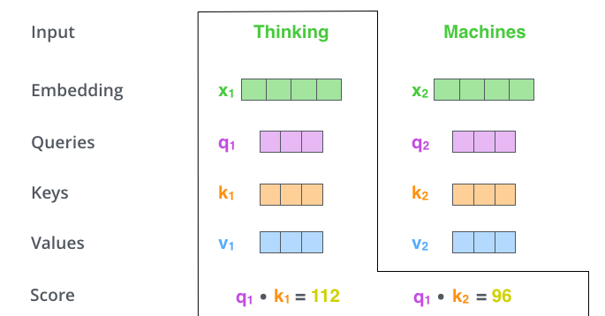
02
Attention and Transformers
Self Attention
Now we need to calculate
a score to determine how
much focus to place on other
Parts of the input.

Slide 25
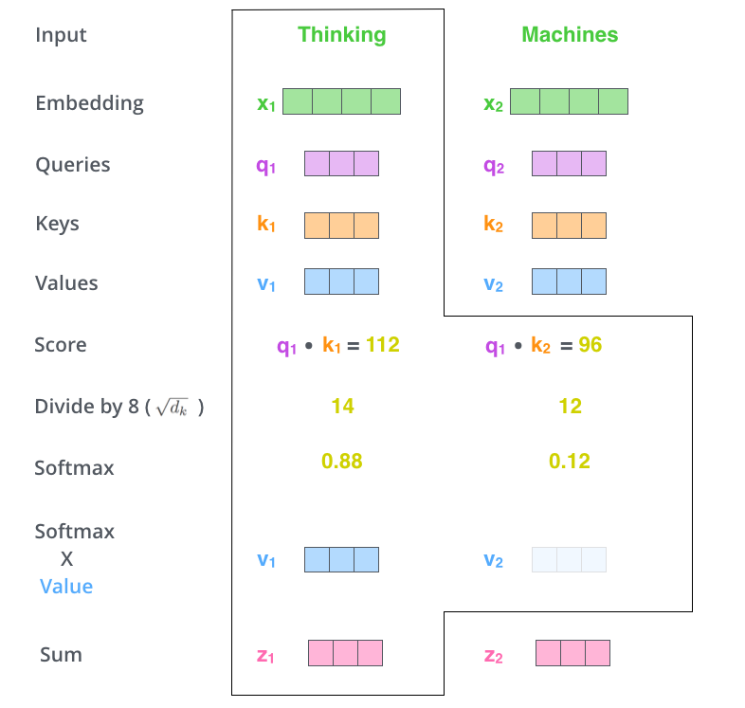
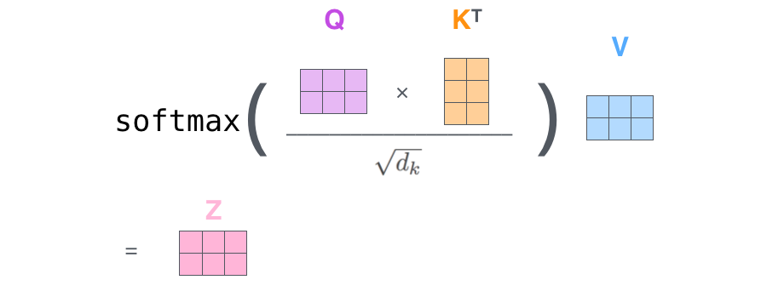
02
Attention and Transformers
Self Attention
Formula
64x64
64x512
~
~
d_{k}=64 is dimension of key vector
z₁= 0.88v₁+ 0.12v₂
Notes:
v~

Slide 26
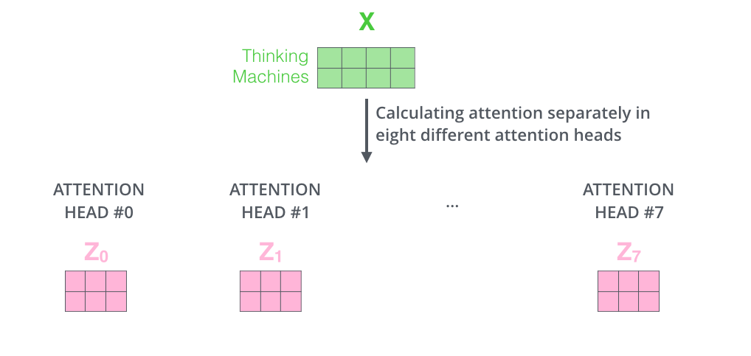
02
Attention and Transformers
Multiple heads
It expands the model’s ability to focus on different positions.
It gives the attention layer multiple “representation subspaces”

Slide 27
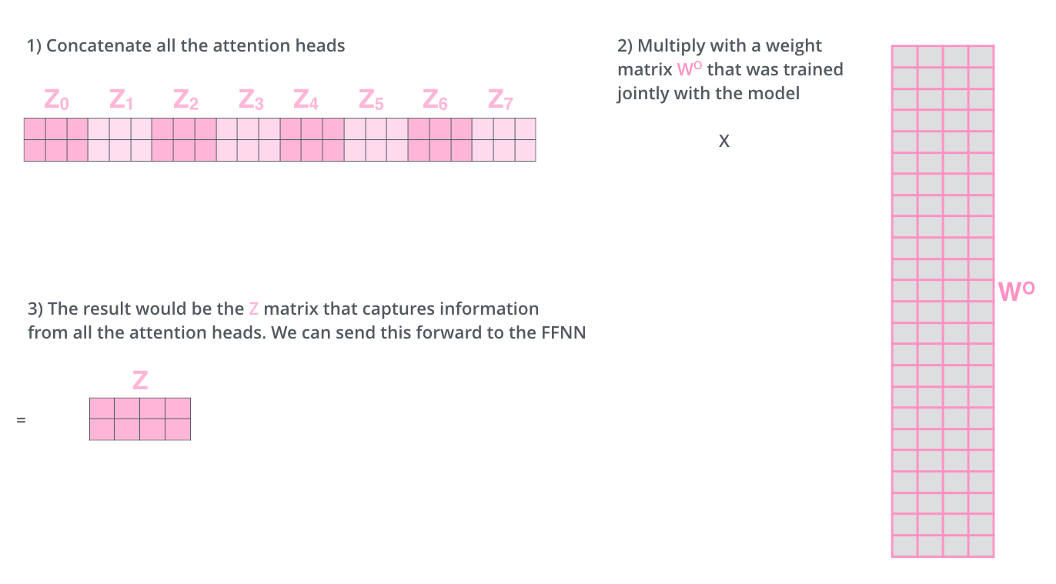
02
Attention and Transformers
4
The output is expecting only a 2x4 matrix, hence,
24
If you want some more intuition on attention: watch https://www.youtube.com/watch?v=-9vVhYEXeyQ
Notes:
What about order? What happens if scale of these vectors are out of proportion?

Slide 28
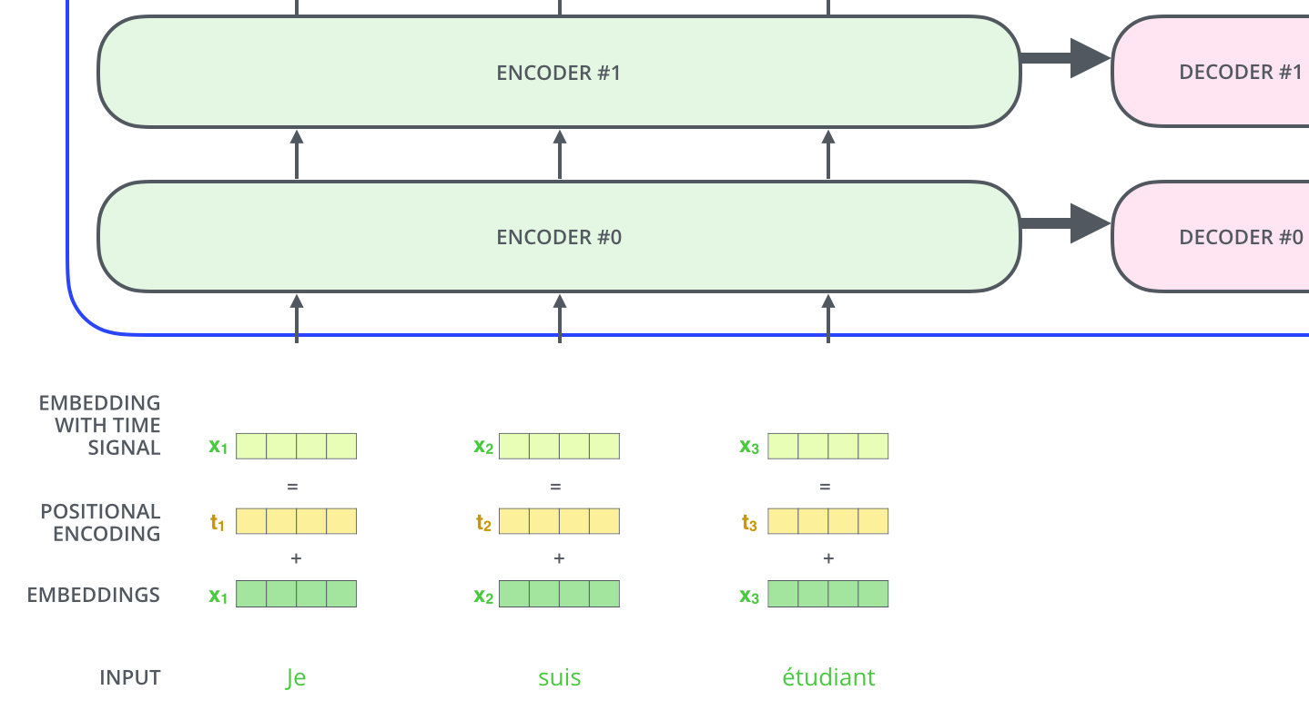
02
Attention and Transformers
Representing the input order (positional encoding)
The transformer adds a vector to each input embedding. These vectors follow a specific pattern that the model learns, which helps it determine the position of each word, or the distance between different words in the sequence. The intuition here is that adding these values to the embedings provides meaningful distances between the embedding vectors once they’re projected into Q/K/V vectors and during dot-product attention.
More on positional encoding: https://kazemnejad.com/blog/transformer_architecture_positional_encoding/

Slide 29
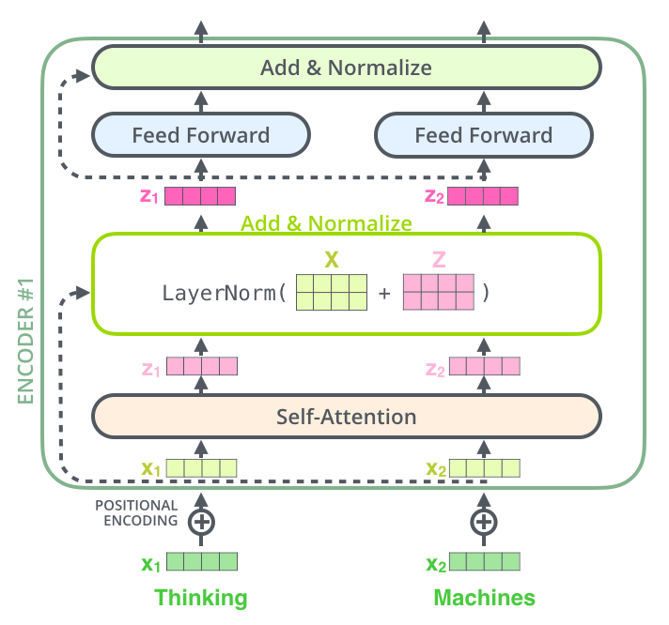
02
Attention and Transformers
Add and Normalize
In order to regulate the computation, this is a normalization layer so that each feature (column) have the same average and deviation.

Slide 30
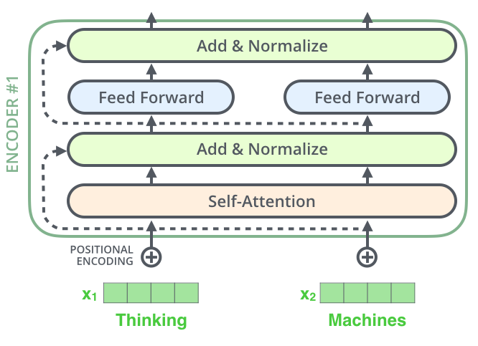
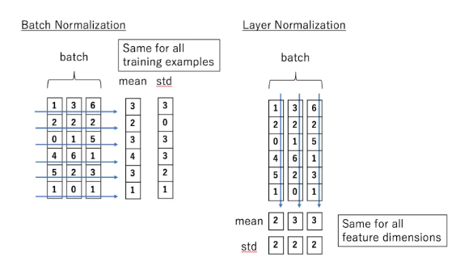
02
Attention and Transformers
Layer Normalization (Hinton)
Layer normalization normalizes the inputs across the features.

Slide 31
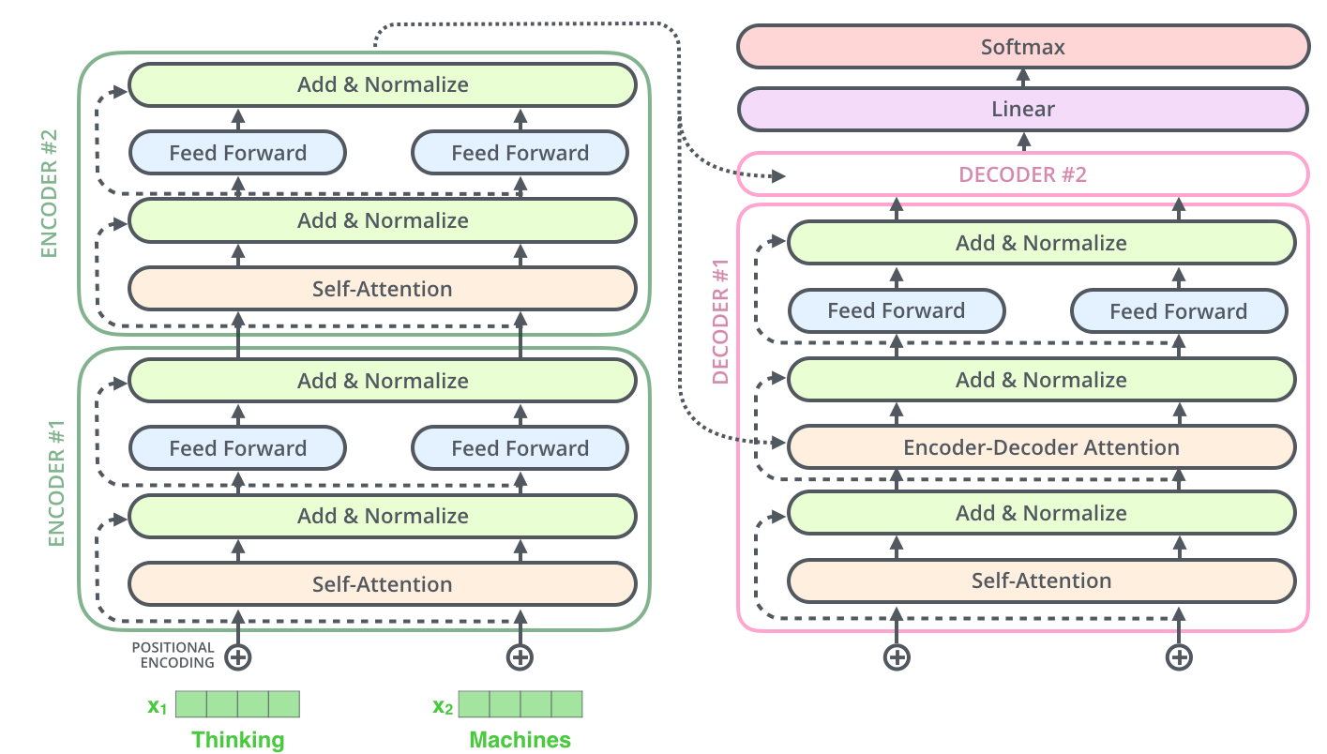
The complete transformer
02
Attention and Transformers
The encoder-decoder attention is just like self attention, except it uses K, V from the top of encoder output, and its own Q

Slide 32
02
Attention and Transformers
Note: In decoder, the input is “incomplete”when calculating self-attention.
The solution is to set future unknown values with “-inf”.

Slide 33
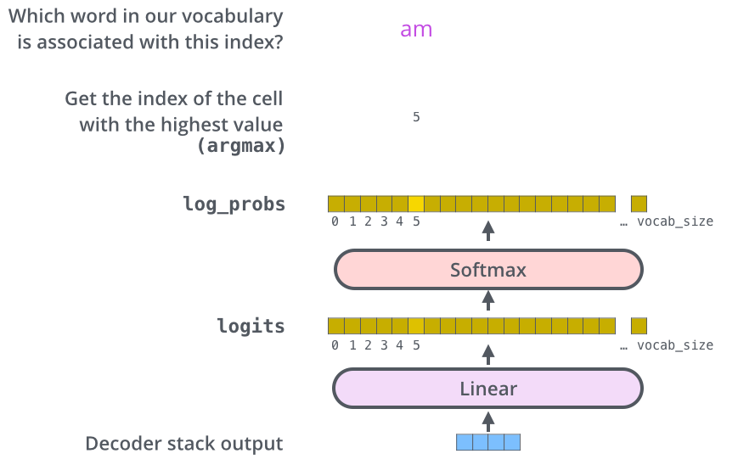
02
Attention and Transformers
Decoder's
Output
Linear
Layer

Slide 34
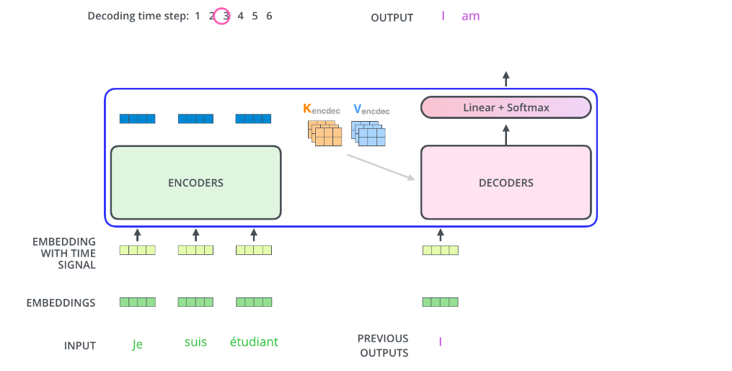
Attention and Transformers
How it works
02
Decoder’s
Output
Linear
Layer
But what about
Self-attention?

Slide 35
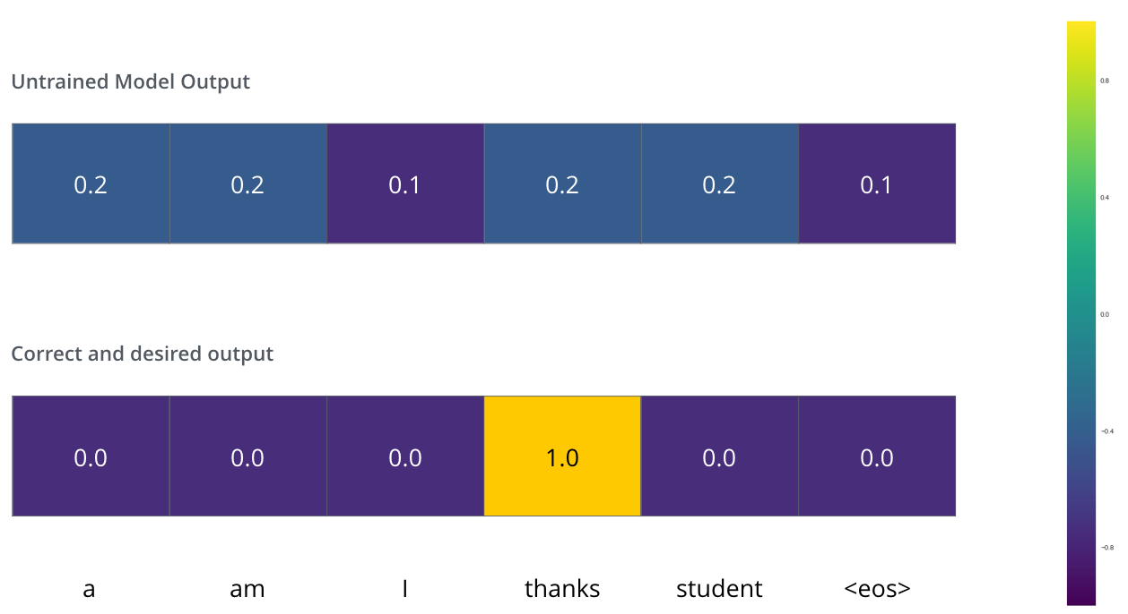
02
Attention and Transformers
Training and the Loss Function
We can use cross
Entropy.
We can also optimize two words at a time: using BEAM search: keep a few alternatives for the first word.

Slide 36
02
Attention and Transformers
Cross Entropy and KL (Kullback-Leibler) divergence
Entropy: E(P) = - Σ_{i}P(i)logP(i) - expected prefix-free code length (also optimal)
Cross Entropy: C(P) = - Σ_{i}P(i) log Q(i) – expected coding
length using optimal code for Q
KL divergence:
D_{KL}(P || Q) = Σ_{i}P(i)log[P(i)/Q(i)] = Σ_{i}P(i)[logP(i) – logQ(i)], extra bits to code
using Q rather than P
JSD(P||Q) = ½ D_{KL}(P||M)+ ½ D_{KL}(Q||M), M= ½ (P+Q), symmetric KL
* JSD = Jensen-Shannon Divergency

Slide 37
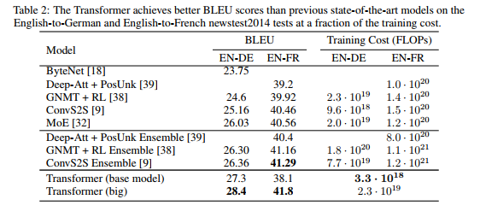
02
Attention and Transformers
Transformer Results

Slide 38
Next Lecture: Pretraining
02
Attention and Transformers
BERT
GPT

Slide 39
02
Attention and Transformers
Literature & Resources for Transformers
Vaswani et al. Attention is all you need. 2017.
Resources:
https://nlp.seas.harvard.edu/2018/04/03/attention.html (Excellent explanation of transformer model with codes.)
Jay Alammar, The illustrated transformer (from which I borrowed many pictures):
http://jalammar.github.io/illustrated-transformer/

